Slide 1
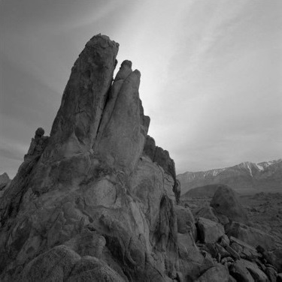
Catch These signs
A memoir on:
CNN
MLP
&
KNN

Slide 2

The Problem – What is this hand trying to tell me
Classifying The American Manual Alphabet Using Machine Learning
Sign language is one of the most popular minority languages used in the United States and is experiencing an increase in demand for tech to assist the deaf.
Our goal is to identify different hand signs to help foster communication between sign users and a non sign users.

Slide 3

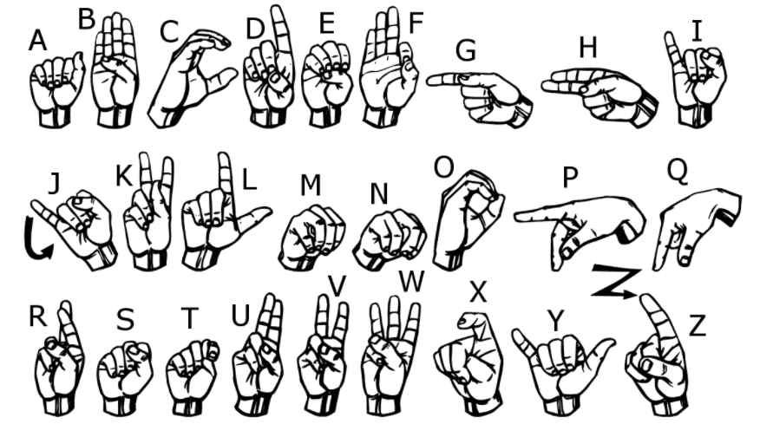
The data
The American Sign Language letter database of hand gestures represent a multi-class problem with 24 classes of letters (excluding J and Z which require motion).

Slide 4
The algorithms
CNN
MLP
KNN

Slide 5
CNn – hold out
Hold-out is when you split up your dataset into a ‘train’ and ‘test’ set. The training set is what the model is trained on, and the test set is used to see how well that model performs on unseen data. A common split when using the hold-out method is using 80% of data for training and the remaining 20% of the data for testing.
For this project a %50 split was used.
The hold-out method is good to use when you have a very large dataset, you’re on a time crunch, or you are starting to build an initial model in your data science project.

Slide 6
CNN – Data
Epoch 100, Cost: 272441072.4375, Accuracy: 28.125 % Epoch 200, Cost: 87579234.5, Accuracy: 54.6875 % Epoch 300, Cost: 31498807.5625, Accuracy: 69.53125 % … Epoch 1300, Cost: 639455.4375, Accuracy: 95.3125 % Epoch 1400, Cost: 372599.859375, Accuracy: 96.875 % … Epoch 1900, Cost: 317734.9296875, Accuracy: 95.3125 % Epoch 2000, Cost: 99318.984375, Accuracy: 99.21875 %
Accuracy on Training Data: 97.83081412315369 % Accuracy on Test Data: 96.92087173461914 %

Slide 7
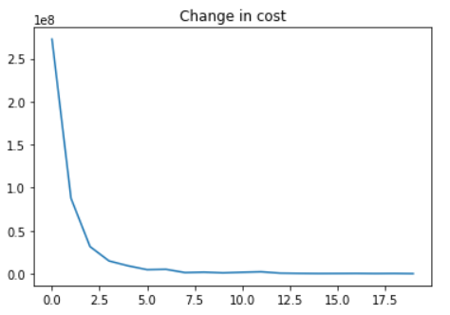
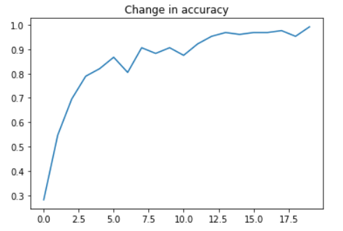
CNN – Graphs

Slide 8
MLP (Multilayer Perceptron) – Background
What is Multilayer Perceptron?
- MLP contains many perceptrons that are organized into layers - Perceptrons are binary classifiers - A class of feedforward artificial neural network (non circular) - An MLP consists of at least three layers of nodes: an input layer, a hidden layer and an output layer. (Can have many hidden layers) - Except for the input nodes, each node is a neuron that uses a nonlinear activation function - A linear activation function maps the weighted inputs to the output of each neuron, then linear algebra shows that any number of layers can be reduced to a two-layer input-output model - MLP utilizes a supervised learning technique called backpropagation for training (backpropogation = a way of propagating the total loss back into the neural network to know how much of the loss every node is responsible for, and subsequently updating the weights in such a way that minimizes the loss by giving the nodes with higher error rates lower weights and vice versa)

Slide 9
MLp – Continued
How did we train this Neural Network?- Learning occurs in the perceptron by changing connection weights after each piece of data is processed, based on the amount of error in the output compared to the expected result - Code Example: layer1 = tf.nn.relu(tf.add(tf.matmul(x, weights['w1']), biases['b1'])) layer2 = tf.nn.relu(tf.add(tf.matmul(layer1, weights['w2']), biases['b2'])) layer3 = tf.nn.relu(tf.add(tf.matmul(layer2, weights['w3']), biases['b3'])) layer4 = tf.nn.relu(tf.add(tf.matmul(layer3, weights['w4']), biases['b4'])) layer5 = tf.nn.relu(tf.add(tf.matmul(layer4, weights['w5']), biases['b5'])) layer6 = tf.nn.relu(tf.add(tf.matmul(layer5, weights['w6']), biases['b6'])) layer7 = tf.nn.relu(tf.add(tf.matmul(layer6, weights['w7']), biases['b7'])) layer8 = tf.nn.relu(tf.add(tf.matmul(layer7, weights['w8']), biases['b8'])) layer9 = tf.nn.relu(tf.add(tf.matmul(layer8, weights['w9']), biases['b9'])) layer10 = tf.nn.relu(tf.add(tf.matmul(layer9, weights['w10']), biases['b10'])) layer_out = tf.matmul(layer10, weights['_w']) + biases['_b']Loss function: Cross Entropy Optimizer: Adam Activation Function: Relu (Rectified linear unit) Layers: 10 Learning Rate: 0.002 Epochs: 5000

Slide 10
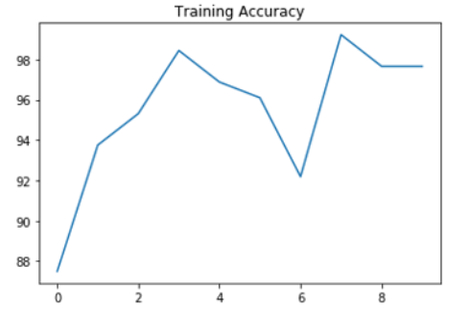
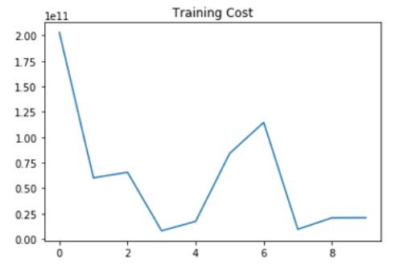
Mlp – data (Training)

Slide 11
Mlp – epochs (Training)
Epoch 500: Cost: 203147950000.0, Accuracy: 87.5 Epoch 1000: Cost: 60088600000.0, Accuracy: 93.75 Epoch 1500: Cost: 65588830000.0, Accuracy: 95.3125 Epoch 2000: Cost: 8086569000.0, Accuracy: 98.4375 Epoch 2500: Cost: 17318814000.0, Accuracy: 96.875 Epoch 3000: Cost: 84129260000.0, Accuracy: 96.09375 Epoch 3500: Cost: 114643570000.0, Accuracy: 92.1875 Epoch 4000: Cost: 9577546000.0, Accuracy: 99.21875 Epoch 4500: Cost: 20741984000.0, Accuracy: 97.65625 Epoch 5000: Cost: 20882977000.0, Accuracy: 97.65625 Accuracy on train data: 96.35767340660095 %

Slide 12
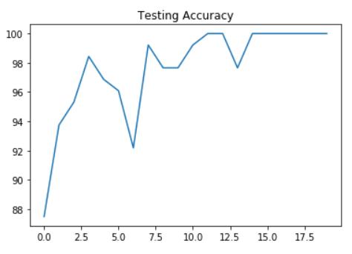
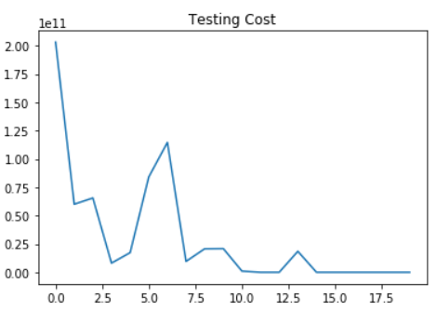
Mlp – data (testing)

Slide 13
Mlp – epochs (testing )
Epoch 500: Cost: 1006870500.0, Accuracy: 99.21875 Epoch 1000: Cost: 0.0, Accuracy: 100.0 Epoch 1500: Cost: 0.0, Accuracy: 100.0 Epoch 2000: Cost: 18504060000.0, Accuracy: 97.65625 Epoch 2500: Cost: 0.0, Accuracy: 100.0 Epoch 3000: Cost: 0.0, Accuracy: 100.0 Epoch 3500: Cost: 0.0, Accuracy: 100.0 Epoch 4000: Cost: 0.0, Accuracy: 100.0 Epoch 4500: Cost: 0.0, Accuracy: 100.0 Epoch 5000: Cost: 0.0, Accuracy: 100.0 Accuracy on test data: 99.1355299949646 %

Slide 14
The ALGO overview
CNN - CNNs are a good choice for image recognition because the weights of the convolutional layer being used for feature extraction as well as the fully connected layer being used for classification are determined during the training process. In traditional models for pattern recognition, feature extractors are hand designed.
MLP - Multilayer perceptron is the predecessor to Convolutional Neural Networks. It was once used as image classification due to the use of hidden layers in the neural network. It's good for image classification because it can distinguish data that is not linearly separable
KNN – Also known as the “K” nearest neighbor, where K is the # of nearest neighbors, is a non- parametric, lazy algo. It finds the nearest neighbor (in terms of Euclidean distance) and uses that neighbor’s label to help predict the classification of K. KNN’s are great for image classification because the training phase is much faster compared to other classification algorithms (instance - based).

Slide 15
